Slide 1
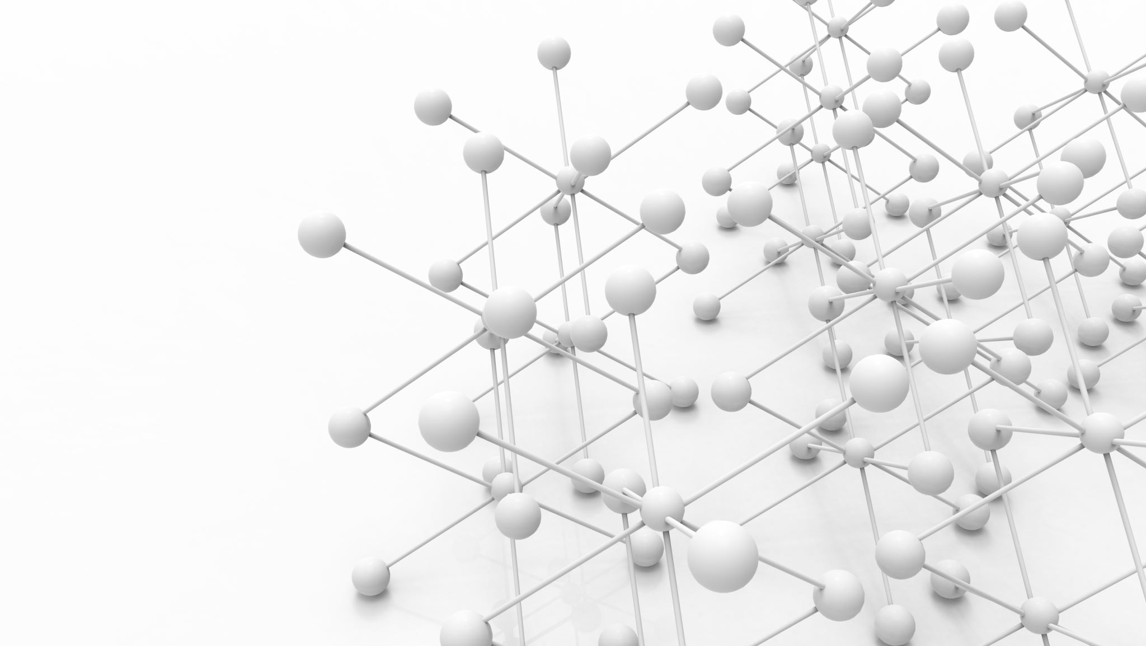
Student : Saloni Aggarwal Advisor : Dr. Linwei Wang
Learning Diffeomorphism-based Data Augmentation

Slide 2
Dataset
CT Scan images of 300 patients
Collected from a center between 2010 and 2018
Collected from - https://github.com/neheller/kits21
More information - https://arxiv.org/abs/1904.00445

Slide 3
Motivation
For building an efficient Deep Neural Network (DNN) lots of labeled data is necessary.
In real-life applications this is not always possible.
Data Augmentation is one of the techniques to handle this problem where new samples are created and added to existing dataset.
Notes:
Data augmentation can be done using various operations like we can rotate an image, scale an image, transform an image etc.,

Slide 4
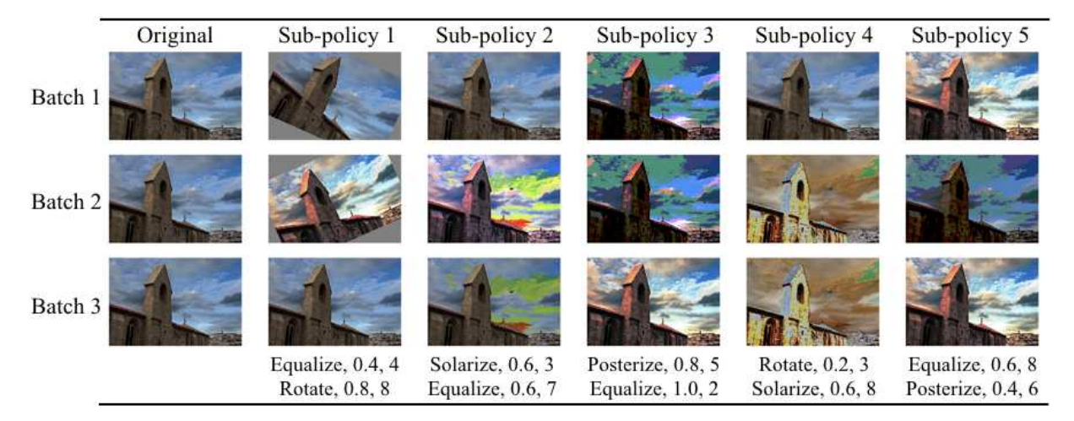
Prior Work
Previously designed state-of-the-art reduces the efforts of selecting the best operations and parameters for a given task and dataset. But these transformations are limited to operations like rotation, scaling, translations, etc.
Notes:
First model that was built would select the best transformation operation for a given task and dataset.

Slide 5
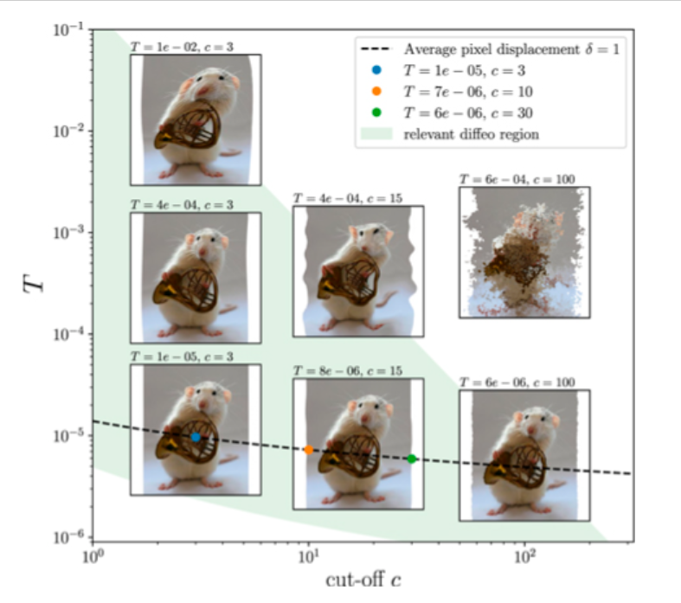
Prior Work
Some other papers have designed global transformation by learning more expressive augmentations. This method allow modelling object's shape variations which is important for image segmentation task.

Slide 6
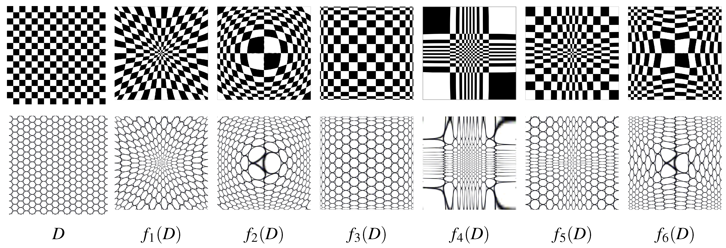
What is diffeomorphism?
Notes:
Diffeomorphism is a technique of forming different variations of one image. It foes this by determining the changes in the velocity or point of spread of each pixel in input image. It tells that how much each pixel should move in order to get a variation in the image.

Slide 7
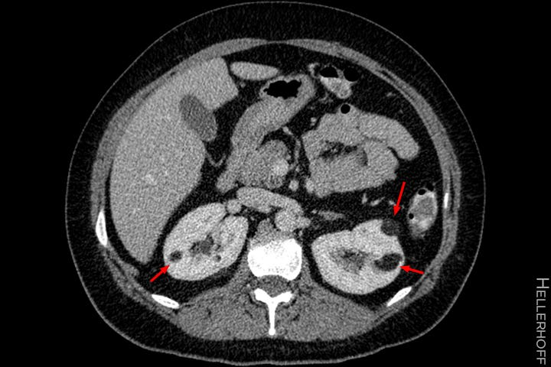
Overview
Propose an object-centric augmentation method.
This will be achieved by transforming the object of interest using variations in different instances of the object called diffeomorphism.
Notes:
In my project I will segment out the tumor from the images and then create different variations of these tumors using diffeomorphism technique.

Slide 8
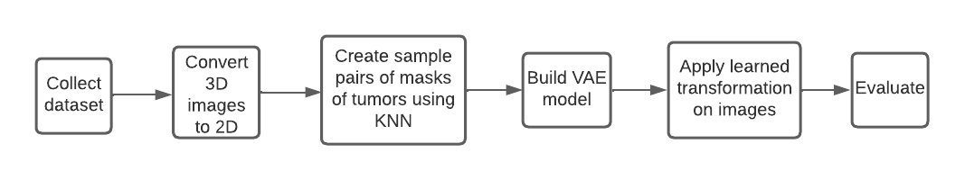
Architecture

Slide 9
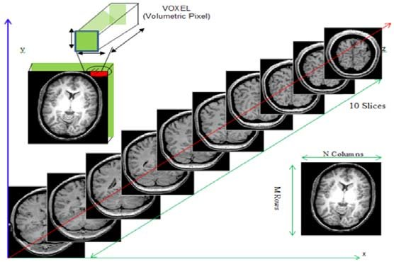
Converting from 3D to 2D
(x, y, z) = (67, 56, 10)
Notes:
A CT Scan is nothing but volume of images. A 2D image in made up of pixels, similarly 3D images are made of voxels. 3D images have three dimensions and suppose their values are 67, 56 and 10. So that means there are 10 images of 67x56 resolution and thus I extracted each image. So I have 10 image of 67x56 resolution from one CT scan.

Slide 10
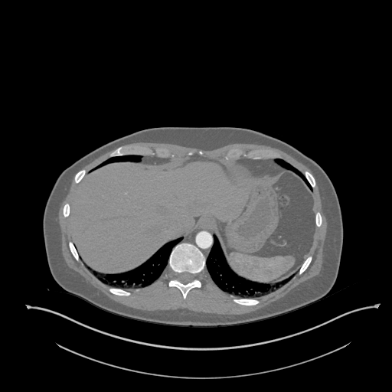
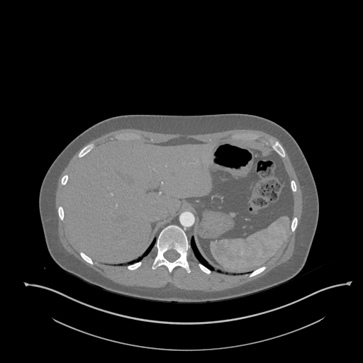
Converting from 3D to 2D
Notes:
These are 2D images that I got as output from two different CT scans of kidney tumor. Now I am working on forming the sample pairs using KNN.

Slide 11
Thank You !
Questions?

